Slide 1
How to Be PRACTICALLY Christian:
Covenant Discipleship Groups in Church and Community
700
82,000
220,000
Great Churches
Great Leaders
Great Disciples
Transformed World

Slide 2
Honey, I Shrunk the Church!
Great Churches
Great Leaders
Great Disciples
Transformed World

Slide 3
How to Be PRACTICALLY Christian:
Covenant Discipleship Groups in Church and Community
Great Churches
Great Leaders
Great Disciples
Transformed World

Slide 4
How to Be Practically Christian

Slide 5
Practice, Practice, Practice!
Great Churches
Great Leaders
Great Disciples
Transformed World

Slide 6
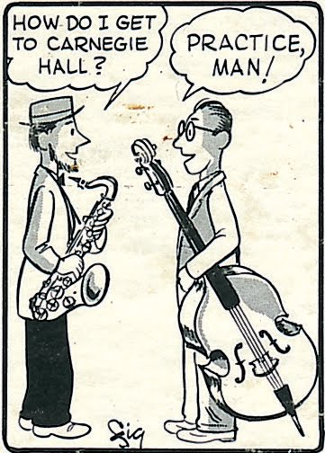
Great Churches
Great Leaders
Great Disciples
Transformed World

Slide 7
How to Be PRACTICALLY Christian?
Great Churches
Great Leaders
Great Disciples
Transformed World

Slide 8
How to Be PRACTICALLY Christian
Forgiveness
Restored relationship
Reconciliation with God
Great Churches
Great Leaders
Great Disciples
Transformed World

Slide 9
How to Be PRACTICALLY Christian
A radical commitment to Jesus of Nazareth.
Accepting his lifestyle and following his teachings.
Taking seriously what Jesus had to say about the kingdom of God—and patterning our lives as if it is already present.
Putting all of that into practice within the routine of daily living.
Great Churches
Great Leaders
Great Disciples
Transformed World

Slide 10
How to Be PRACTICALLY Christian
“Salvation with responsibility”
Great Churches
Great Leaders
Great Disciples
Transformed World

Slide 11
How to Be PRACTICALLY Christian
What is the goal of the Christian life?
Great Churches
Great Leaders
Great Disciples
Transformed World

Slide 12
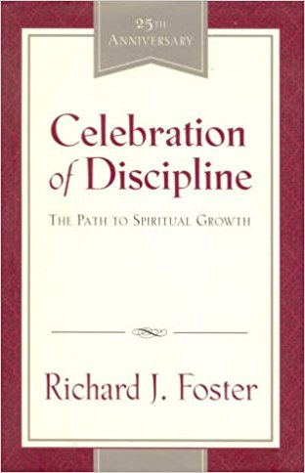
Celebration of Discipline by Richard J. Foster
Great Churches
Great Leaders
Great Disciples
Transformed World

Slide 13
Celebration of Discipline by Richard J. Foster
To
be
like
Jesus.
Great Churches
Great Leaders
Great Disciples
Transformed World

Slide 14
WHAT IS JESUS LIKE?
Great Churches
Great Leaders
Great Disciples
Transformed World

Slide 15
How to Be PRACTICALLY Christian
“To be formed, conformed, and transformed into the image and likeness of Jesus.” --Richard Foster
Great Churches
Great Leaders
Great Disciples
Transformed World

Slide 16
How to Be PRACTICALLY Christian
Sanctification
Great Churches
Great Leaders
Great Disciples
Transformed World

Slide 17
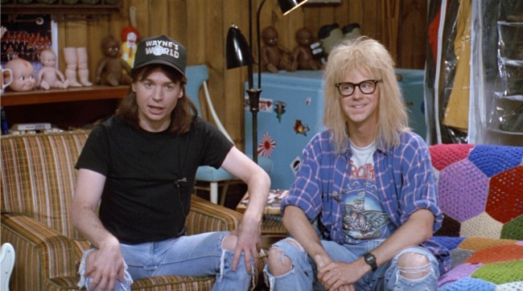
Great Churches
Great Leaders
Great Disciples
Transformed World

Slide 18
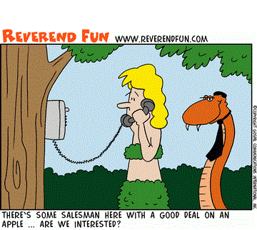
Great Churches
Great Leaders
Great Disciples
Transformed World

Slide 19
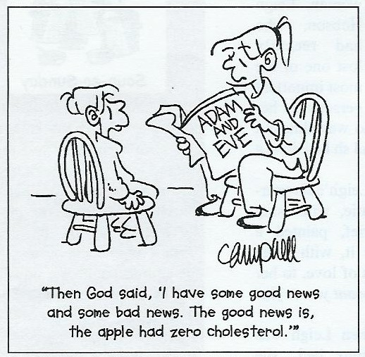
Great Churches
Great Leaders
Great Disciples
Transformed World

Slide 20
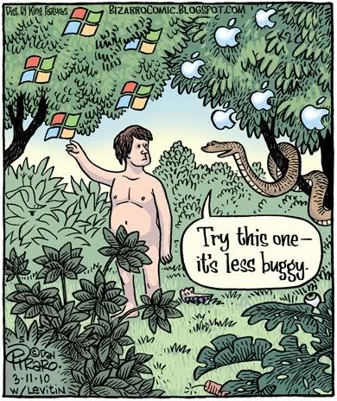
Great Churches
Great Leaders
Great Disciples
Transformed World

Slide 21
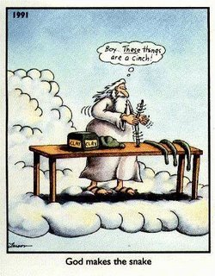
Great Churches
Great Leaders
Great Disciples
Transformed World

Slide 22
How to Be PRACTICALLY Christian
Total Depravity
Great Churches
Great Leaders
Great Disciples
Transformed World

Slide 23
How to Be PRACTICALLY Christian
Limited depravity
Great Churches
Great Leaders
Great Disciples
Transformed World

Slide 24
How to Be PRACTICALLY Christian
“Replacing the devilish mind that is within us with the mind that is in Christ Jesus.”
--John Wesley
Great Churches
Great Leaders
Great Disciples
Transformed World

Slide 25
How to Be PRACTICALLY Christian
A Theology of Grace
Great Churches
Great Leaders
Great Disciples
Transformed World

Slide 26
How to Be PRACTICALLY Christian
“Cooperating” with God’s grace
Great Churches
Great Leaders
Great Disciples
Transformed World

Slide 27
How to Be PRACTICALLY Christian
Cooperating with Grace?
Great Churches
Great Leaders
Great Disciples
Transformed World

Slide 28
How to Be PRACTICALLY Christian
Grace: Unmerited favor….and POWER!
Great Churches
Great Leaders
Great Disciples
Transformed World

Slide 29
How to Be PRACTICALLY Christian
The Means of Grace
Great Churches
Great Leaders
Great Disciples
Transformed World

Slide 30
How to Be PRACTICALLY Christian
Means of Grace:
The channels which God has established through the organized, institutional Church by which God’s gracious blessings are given to God’s people. They are how we cooperate with God!
Great Churches
Great Leaders
Great Disciples
Transformed World

Slide 31
(Put some illustration of prayer here if desired)

Slide 32
How to Be PRACTICALLY Christian
Prayer
Meditation
Fasting
Great Churches
Great Leaders
Great Disciples
Transformed World

Slide 33
How to Be PRACTICALLY Christian
Study
Simplicity
Solitude
Great Churches
Great Leaders
Great Disciples
Transformed World

Slide 34
How to Be PRACTICALLY Christian
Submission
Service
Confession
Great Churches
Great Leaders
Great Disciples
Transformed World

Slide 35
How to Be PRACTICALLY Christian
Worship
Guidance
Celebration
Great Churches
Great Leaders
Great Disciples
Transformed World

Slide 36
How to Be PRACTICALLY Christian
A spiritual discipline is “doing what we can do with our body, mind and spirit in order to receive from God the power and resources we need to do what we cannot do in our own strength.”
Great Churches
Great Leaders
Great Disciples
Transformed World

Slide 37
How to Be PRACTICALLY Christian
Richard Foster:
“We undertake things we can do in order to receive power from God to do what we cannot do. That is what a spiritual discipline is.”
Great Churches
Great Leaders
Great Disciples
Transformed World

Slide 38
How to Be PRACTICALLY Christian
Practice! Practice! Practice!
Great Churches
Great Leaders
Great Disciples
Transformed World

Slide 39
How to Be PRACTICALLY Christian
“Talent is overrated. We all start pretty ordinary. You become extraordinary through the transformational process of practice.”
(Matthew Syed, Bounce: Mozart, Federer, Picasso, Beckham and the Science of Success)
Great Churches
Great Leaders
Great Disciples
Transformed World

Slide 40
How to Be PRACTICALLY Christian
ACCOUNTABILITY
Great Churches
Great Leaders
Great Disciples
Transformed World

Slide 41
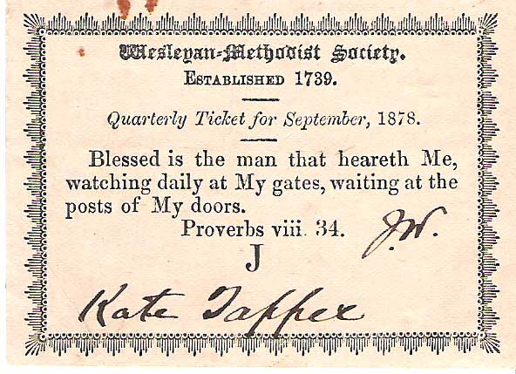
Great Churches
Great Leaders
Great Disciples
Transformed World

Slide 42
How to Be PRACTICALLY Christian
Covenant Discipleship Groups in Church and Community
ACCOUNTABILITY
Great Churches
Great Leaders
Great Disciples
Transformed World

Slide 43
How to Be PRACTICALLY Christian
Covenant Discipleship Groups (Results)
1. You will become more aware of God’s grace in your life.
2. You will find new ways of serving God and your neighbor in the world.
3. You will find your understanding of God’s will in your life greatly enhanced.
Great Churches
Great Leaders
Great Disciples
Transformed World

Slide 44
How to Be PRACTICALLY Christian
Covenant Discipleship Groups: FAQs
Q: How large or small?
Answer: 2 – 7. Why? To get through in an hour.
Q: What is the average or optimum size of a group?
Answer: 5 – 6. Why? Room to grow. Good dynamic even if someone is missing.
.
Great Churches
Great Leaders
Great Disciples
Transformed World

Slide 45
How to Be PRACTICALLY Christian
Covenant Discipleship Groups FAQs:
Q: What is the task?
Answer: To watch over each other in love.
Q: Toward what end or goal?
Answer: To develop consistency and maturity in our walk with Christ. To become more like Jesus.
Great Churches
Great Leaders
Great Disciples
Transformed World

Slide 46
How to Be PRACTICALLY Christian
Covenant Discipleship Groups FAQs:
Q: What is the top priority for members of CDGs?
Answer: BE THERE!
Great Churches
Great Leaders
Great Disciples
Transformed World

Slide 47
How to Be PRACTICALLY Christian
Covenant Discipleship Groups in Church and Community:
The Covenant
Great Churches
Great Leaders
Great Disciples
Transformed World

Slide 48
How to Be PRACTICALLY Christian
The Covenant—3 parts:
Preamble
Clauses
Conclusion
Great Churches
Great Leaders
Great Disciples
Transformed World

Slide 49
How to Be PRACTICALLY Christian
An Example of a Covenant of Discipleship
Preamble
Knowing that Jesus Christ died that I might have eternal life, I herewith pledge myself to be his disciple, witnessing to his saving grace, and seeking to follow his teachings under the guidance of the Holy Spirit. I faithfully pledge my time, my skills, my resources, and my strength, to search out God’s will for me, and to obey.
Great Churches
Great Leaders
Great Disciples
Transformed World

Slide 50
How to Be PRACTICALLY Christian
Clauses:
Acts of Compassion
I will spend four hours each month helping the poor people in my community.
I will obey the promptings of the Holy Spirit to serve God and my neighbor.
Great Churches
Great Leaders
Great Disciples
Transformed World

Slide 51
How to Be PRACTICALLY Christian
Acts of Justice
When I am aware of injustice to others, I will not remain silent.
I will heed the warnings of the Holy Spirit not to sin against God and my neighbor.
Great Churches
Great Leaders
Great Disciples
Transformed World

Slide 52
How to Be PRACTICALLY Christian
Acts of Worship
I will worship each Sunday, unless prevented.
I will receive the Sacrament of Holy Communion each week.
Great Churches
Great Leaders
Great Disciples
Transformed World

Slide 53
How to Be PRACTICALLY Christian
Acts of Devotion:
I will read and study the scriptures each day.
I will spend 30 minutes/day devoting myself to God through prayer, personal study and other devotional acts.
Great Churches
Great Leaders
Great Disciples
Transformed World

Slide 54
How to Be PRACTICALLY Christian
Conclusion
I hereby make my commitment, trusting in the grace of God to give me the will and the strength to keep this covenant.
Date:___________________
Signed:______________________________________
Great Churches
Great Leaders
Great Disciples
Transformed World

Slide 55
How to Be PRACTICALLY Christian
Add an Element of Accountability to Already Existing Church Groups
Are you attending worship regularly?
Are you reading your Bible devotedly?
Are you praying daily?
Are you reproducing the love of Jesus in the world consistently?
Great Churches
Great Leaders
Great Disciples
Transformed World

Slide 56
How to Be PRACTICALLY Christian
Covenant Discipleship Groups in the Community
Coffee Shop Group
After Kiwanis or Rotary Group
Online Group around Pinterest or Facebook
Great Churches
Great Leaders
Great Disciples
Transformed World

Slide 57
How to Be PRACTICALLY Christian
Covenant Discipleship Groups in the Community
Afterschool Group
Local jail or prison
Community colleges
Great Churches
Great Leaders
Great Disciples
Transformed World

Slide 58
How to Be PRACTICALLY Christian
“Many Christians today are ready to make a disciplined commitment to their discipleship. They reject the option of lukewarm religion, which demands little of the believer and offers all sorts of personal benefits the church was never meant to provide…”
--David Lowes Watson
Great Churches
Great Leaders
Great Disciples
Transformed World

Slide 59
How to Be PRACTICALLY Christian
Intentional
Faith Development
Great Churches
Great Leaders
Great Disciples
Transformed World

Slide 60
How to Be PRACTICALLY Christian
First Steps:
Recruit a team to study the book Covenant Discipleship and Celebration of Discipine.
Use this group as a pilot CDG and as guides for the formation of new groups.
Invitation Sunday
Great Churches
Great Leaders
Great Disciples
Transformed World

Slide 61
How to Be PRACTICALLY Christian
Beginning Steps:
Ask for a commitment.
Divide into groups (based entirely on the time of the week that works best).
Great Churches
Great Leaders
Great Disciples
Transformed World

Slide 62
How to Be PRACTICALLY Christian
Beginning Steps:
Schedule the inaugural meetings.
Go for it!
Important!! The pastor must be fully supportive and integrally involved in the entire process.
Great Churches
Great Leaders
Great Disciples
Transformed World

Slide 63
Covenant Covenant Discipleship: Christian Formation through Mutual Accountability by David Lowes Watson
Great Churches
Great Leaders
Great Disciples
Transformed World

Slide 64
Celebration of Discipline by Richard J. Foster
Great Churches
Great Leaders
Great Disciples
Transformed World

Slide 65
How to Be PRACTICALLY Christian:
Covenant Discipleship Groups in Church and Community
700
82,000
220,000
Great Churches
Great Leaders
Great Disciples
Transformed World

Slide 66
How to Be PRACTICALLY Christian
700 clergy
82,000 average worship attendance
220,000 members
Great Churches
Great Leaders
Great Disciples
Transformed World

Slide 67
How to Be PRACTICALLY Christian
220,000
THE LAITY
Spiritually mature laity are the strongest drivers of congregational vitality!
Disciples of Jesus Christ!
Great Churches
Great Leaders
Great Disciples
Transformed World

Slide 68
Honey, I’m in a Covenant Discipleship Group!
Great Churches
Great Leaders
Great Disciples
Transformed World

